Slide 1
TWISUNGANE FARMER GROUP

Slide 2
The Twisungane cooperative farmers have benefited from TFH mentoring
They used their small spaces to grow vegetables and fruits to fight malnutrition in their families especially for their children and pregnant women, through kitchen gardens.
They are still using Irrigation equipment helps them in agriculture production. In a small piece of land such as 0.4 ha the farmers usually used to get approximately 100 kg of vegetables and fruits. After getting the irrigation equipment and technical support from TFH staff, they now get 500 kg of vegetables.

Slide 3
Tools for Hope help
They can now send all their children to school and can buy all the school materials.
They have saving group that will help them to save money to buy materials such as hybrid seed and fertilizer and pay medical insurance (mutuelle de sante). They may borrow from their group's revolving fund and repay loans at an affordable interest rate.
They started to save small amount of money 500 Rwandan Franc (0.5$).It help them in developing ownership of their future i.e., to be able in the long run to solve some of their issues themselves .
All families have opened bank accounts.

Slide 4
TFH
After getting training about business plans now they are able to do a business plan themselves.
Through their own savings, were able to buy pigs and plant bananas as an income generating activity.
Farmers record their farming activities. They calculate their costs and their profits. They keep track of each activity. And in doing so now they have adapted the culture of sitting down and planning together what they are going to plant and to start calculating all necessary costs per each agricultural activity.

Slide 5
Thanksgiving
Twisungane farmers thank TFH for the support provided during lockdown where their families were going to die of hunger as movements were restricted
TFH supported them with a motorcycle taxi business and a goat raising business.

Slide 6
Testimonies
My names is Josiane one of the twisungane group before to join twisungane I was struggle about malnutrition with my children and I didn't know how I can use my small space to grown vegetables and fruit but from skills I gain from TFH mentor now I have 2 kitchen garden in my home.

Slide 7
Testimonies
Through training from TFH mentor I learned to take care of small livestock and through our saving group I borrowed money to buy chicken for meat and eggs.

Slide 8
Samuel, Twisungane Group Leader
My name is Samuel I thank TFH for their support. Before it was difficult to find manure but now, I have manure from goats, and we started to improve our production. And I am able to pay schools fees for my children.

Slide 9
New planned activity
They are waiting for buying and selling a land business.

Slide 10
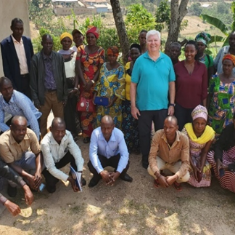
DUFATANYE GROUP
The second group TFH is going to support

Slide 11
The Dufatanye cooperative farmers have benefited from TFH mentoring
They have saving group through which they are able to save small amount 1000 Rwandan Franc ($1.00) every month. It help them in developing ownership of their future i.e., to be able in the long run to solve some of their issues themselves .
All families have opened bank accounts

Slide 12
Dufatanye Group
Farmers start to record their farming activities. They calculate their costs and their profits. They keep track of each activity. In doing so now they have adapted the culture of sitting down and planning together what they are going to plant and to start calculating all necessary costs per each agricultural activity.

Slide 13
New planned activities
They are waiting for pigs farming project which will improve their lives
TFH mentor will train Dufatanye group to build kitchen gardens
TFH mentor will train Dufatanye using no till farming
TFH mentor will help them to avoid post harvesting loss and to help them to link with markets.

